Slide 1
Tobique Valley Middle High School
2020-2021 Operational Plan Highlights

Slide 2
Communication
Mon. 31 Aug.
School Operational Plan will be presented to teachers.
Thu. 3 Sep.
School Operational Plan will be shared with parents via email and website.
Tue. 8 Sep.
Grade 6, 7, 8 students only
Wed. 9 Sep.
Grade 9-12 students only
Thu. 10 Sep.
All students
Week of Aug 31st to Sept 4th
Teachers will contact students for homeroom assignments

Slide 3
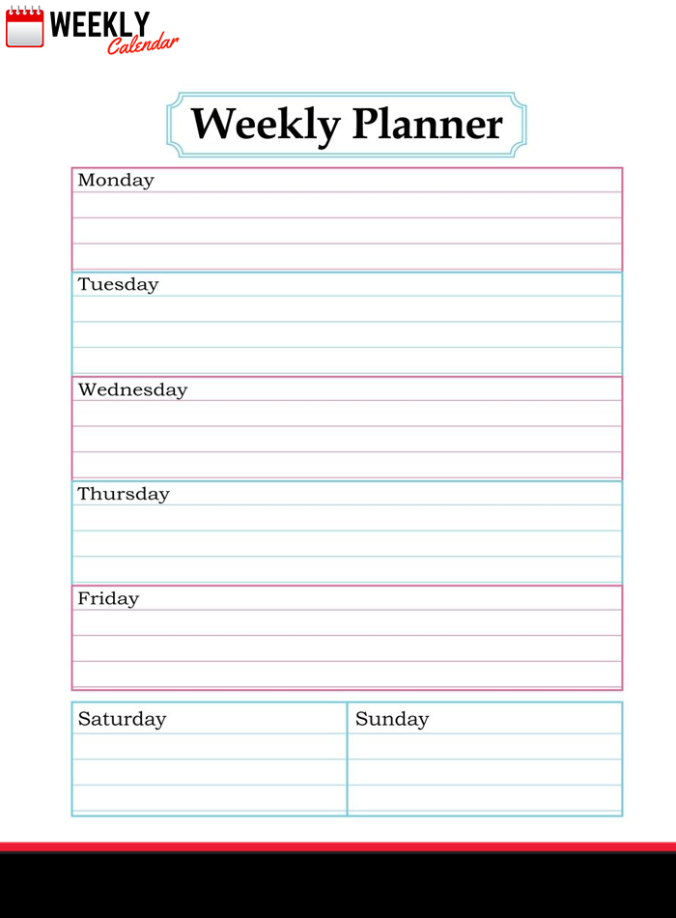
School Days
Unlike some other schools, TVHS students will come to school EVERY day.

Slide 4
Building Access
Parents/caregivers must make an appointment to enter the school.
All visitors other than students will use the main office door.
All visitors will require a mask.
If picking up students early, parents must write a note indicating the pickup time. When arriving at school parents can call the office (356-6015) or ring a bell at the front door.

Slide 5
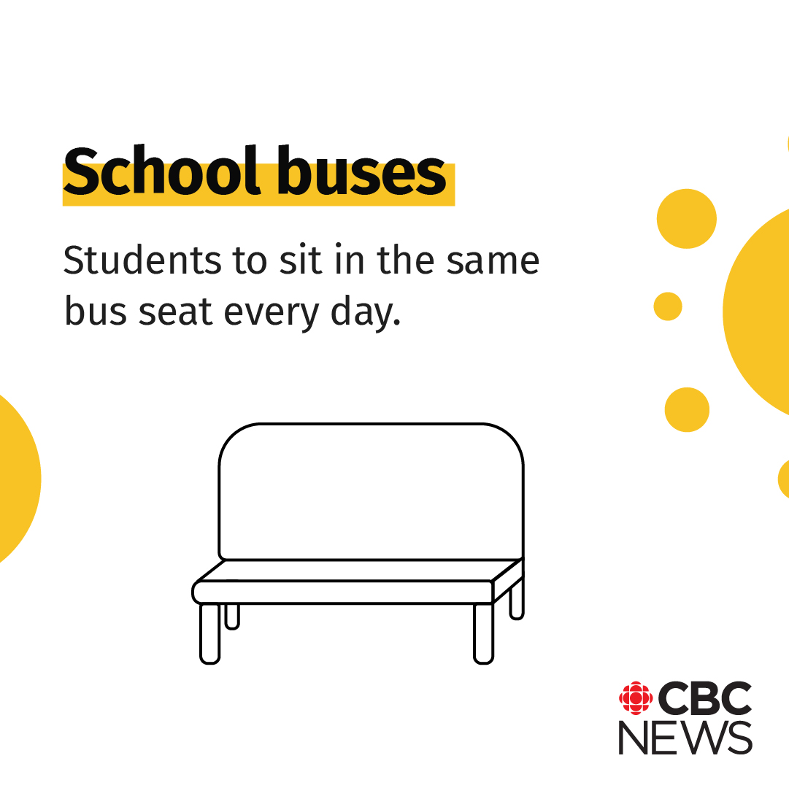
Bussing

Slide 6
Arrival
Arrival time between 8:05 – 8:20
Middle school students will enter through library
High School students will enter through cafeteria
Late students must enter through main office.
Students will wear a face mask when entering and exiting the school.

Slide 7
Drop off Students
Parents dropping students off in the morning:
You MUST follow the busses. No U-turn in the library parking lot.
Middle School students will be dropped off at library door.
High School students will be dropped off at cafeteria door.
Cars MUST follow busses around the building to exit the school parking lot.
Remember, NEVER pass a school bus with flashing lights.

Slide 8
Common Area Procedures
Traffic flow throughout the building will be controlled and/or limited.
Water fountains are prohibited. Remember to bring a water bottle.
Water bottle filling stations will be provided.
Students will wear a face mask at all times outside classrooms.

Slide 9
Common Areas

Slide 10
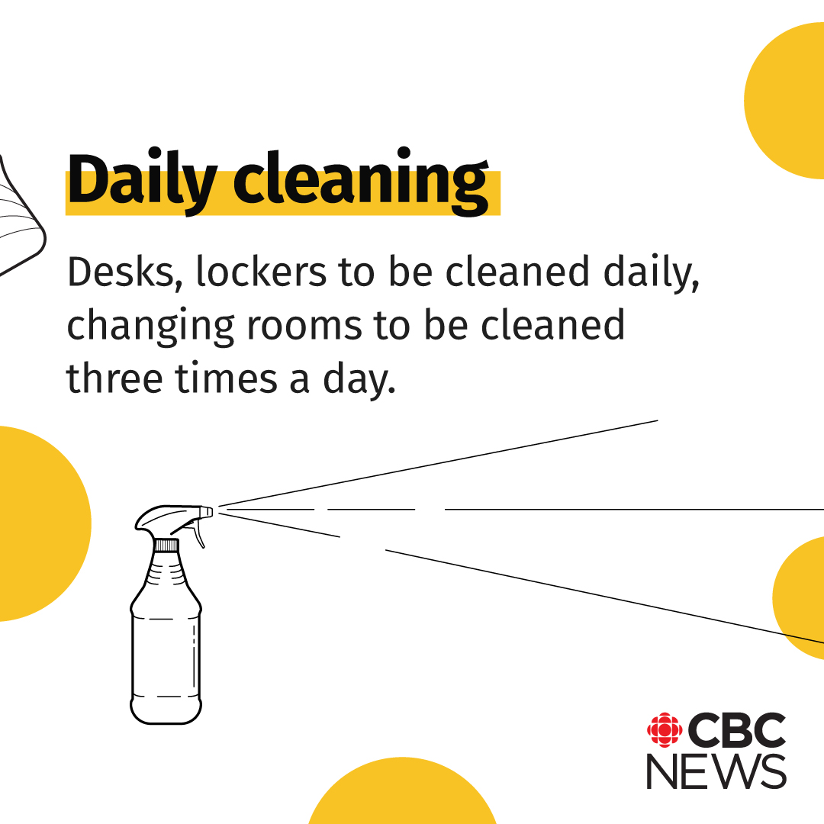
Cleaning Procedures

Slide 11
Lunch Time
Grade 6 students will eat in their homeroom.
Grade 7/8 students will eat in Home Ec. lab or classroom
High school students ordering hot lunch will eat in cafeteria.
Off campus lunch still available for high school students only.

Slide 12
Playground
Each middle school bubble will be provided with a tote of outside equipment to use on their designated day. Middle school students will have a rotational schedule for recess areas (outside and computer lab)
Face masks are not required once on the playground.

Slide 13
Daily Parental Responsibilities
Parents/caregivers will be given a document on symptoms of COVID 19. Parents/caregivers will be asked to take their child’s temperature prior to the child leaving for school.

Slide 14
Daily Parental Responsibilities
Parents/caregivers will be required to ensure that if their child is not feeling well that their child remains at home.

Slide 15
Daily Parental Responsibilities
As per provincial protocol, parents/caregivers will need to have their child tested for COVID 19 when presenting with sufficient symptoms to require testing. Parents/caregivers will be asked to contact 811 if they are unsure if testing is required.

Slide 16
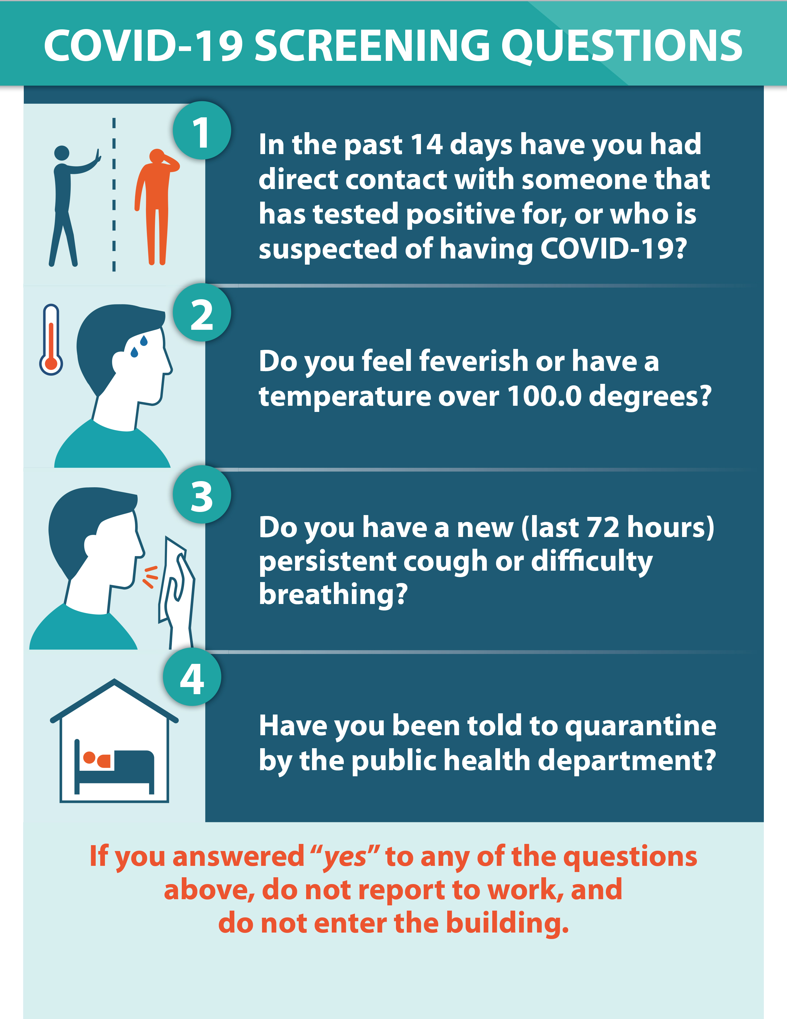
Daily Parental Responsibilities
Members of the public who have an appointment to enter the building will be required to answer the COVID 19 questions prior to entering the building.

Slide 17
If my Child Becomes Sick at School
Students are to self-monitor throughout the day. If students or staff members become ill, they are to report this immediately. Students will immediately move to isolation. Students who begin to feel ill will be required to wear a mask immediately following onset of symptoms. Parents/caregivers will be notified to arrange pick up.
Students will be isolated until pick up by parents/caregivers.

Slide 18
Departure
Middle School walking and pick up students dismissal at 2:50 through library doors.
Middle School bus dismissal at 2:50
High School dismissal at 2:57
Driving High School students dismissal after busses leave.

